Slide 1

Dance Studio Project
Cara, Steven, Dan E and Dan Mc

Slide 2
A brief system description
A Dance studio owner has approached us and wants a new website designing for their company, in order to do this several activities needed to be carried out.
1. Gather information about the old website, and gather requirements for new website.
2. Design a requirement specification for the new system highlighting functional and non functional requirements.
3. Produce several ERD’s and DFD’s so that the system is clear in what operations should be carried out.

Slide 3
Functional Requirements
Shall allow multiple users to log into the website.
Shall allow customers to book a class.
Shall allow customers to pay for a class.
Shall have a contact form to contact the tutors.
Shall have functionality to allow the owner to edit various parts of the website.
Shall have functionality to allow any tutor to edit various parts of the website.
Shall have functionality to update design of the website.
Shall allow advertising of Dance Classes
Shall allow Advertising of events.
Shall have functionality to display testimonials.
Shall allow customers to register an account.
Shall allow customers to change personal details when necessary
Shall allow customers to delete their account when necessary.
Shall use safe storage for customers financial details.
Shall have functionality to display a random selection of testimonials, in a prominent place.

Slide 4
Non-Functional Requirements
Shall be compliant with modern web standards.
Shall be accessible via all web browsers.
Shall be accessible for disabled persons.
Shall use dance studio business colours.
Shall use dance studio business logo.
Shall have use a calendar to visually inform of events and dance classes.
Shall be accessible for all ages, from children to adults.

Slide 5
Use Case Narratives
We found that there are 14 possible use case narratives for this system.
  - Customer profile registration
  - Customer login
  - Tutor profile registration
  - Tutor login
  - Editing of the website
  - Booking
  - Payments
  - Delete account
  - Change details
  - Upload images/videos
  - Feedback response
  - Create a class
  - Cancel a class
  - Unregistered feedback

Slide 6
Customer Profile Registration
Use Case Name: Customer Profile Registration |  |  | ID: 1 | Importance Level: High level
Primary Actor: Customer
Short Description: Customer Profile Registration.
Trigger: Customer clicking register link of the website. Type: External
Major Inputs |  | Major Outputs
Description First Name Second Name D.O.B Address line 1 Address line 2 Town/City Post Code Mob. No. Home. No. Account UserName Account Password. | Source Registration form Registration form Registration form Registration form Registration form Registration form Registration form | Description New Customer account. |  |  | Destination Website Database.
Major Steps Performed: Customer enters information to registration form Customer clicks the submit button. Data is saved in the website accounts database. Customer can not log into the website. |  |  |  | Information for Steps:
Other inputs that could also be considered:
- Doctors phone number
- Known Medical Conditions
- Disablement
- Emergency contact number

Slide 7
Customer Login
Other details that could be considered:
- Forgot Username
- Forgot Password
- CAPTCHA
- T’s & C’s
Use Case Name: Customer Log in |  |  | ID: 2 | Importance Level: Low level
Primary Actor: Customer
Short Description: Customer Login.
Trigger: Customer clicking logon link on the website. Type: External
Major Inputs |  | Major Outputs
Description Account UserName Account Password. | Source Registration form Registration form | Description Current User |  |  | Destination Website Database.
Major Steps Performed: Customer enters Account username and password. Customer Clicks the submit button. Customer is now able to see website as normal, but with added functions i.e. book a dance class and pay for it. |  |  |  | Information for Steps:

Slide 8
Customer Booking
Use Case Name: Customer Booking |  |  | ID: 4 | Importance Level: Low level
Primary Actor: Customer
Short Description: Customer books a class
Trigger: Customer clicks book a class. Type: External
Major Inputs |  | Major Outputs
Description Name Email Booking date desired | Source Booking form Booking form Booking form | Description Booking form. |  |  | Destination Class Database. Calendar
Major Steps Performed: Customer fills out a booking form Customer submits form Date of booking is checked against the calendar for availability Confirmation is sent |  |  |  | Information for Steps:
Other inputs that could also be considered:
Alternate Date
Alternate Time
Alternate Class

Slide 9
Customer Feedback
Use Case Name: Customer Feedback |  |  | ID: 6 | Importance Level: Low Level
Primary Actor: Customer
Short Description: Customer fills out a feedback form for a class
Trigger: Customer click the feedback button on a class. Type: External
Major Inputs |  | Major Outputs
Description Name Email Class Date Tutor | Source Feedback form Feedback form Feedback form | Description Feedback Form |  |  | Destination Feedback Database.
Major Steps Performed: Customer fills out feedback form Customer submits form Date of booking is checked against calendar Confirmation is sent |  |  |  | Information for Steps:
Other details that could be considered:
- Upload media

Slide 10
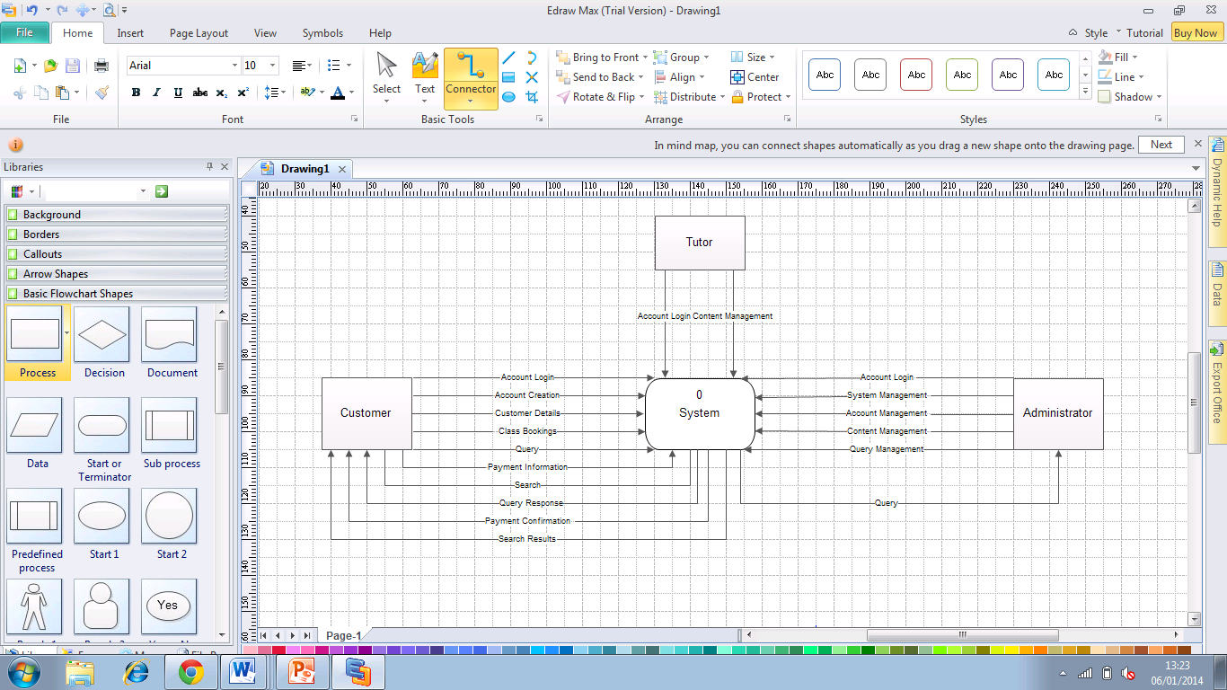
Context Diagram

Slide 11
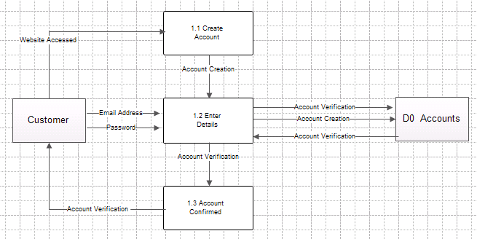
DFD - Create Account

Slide 12
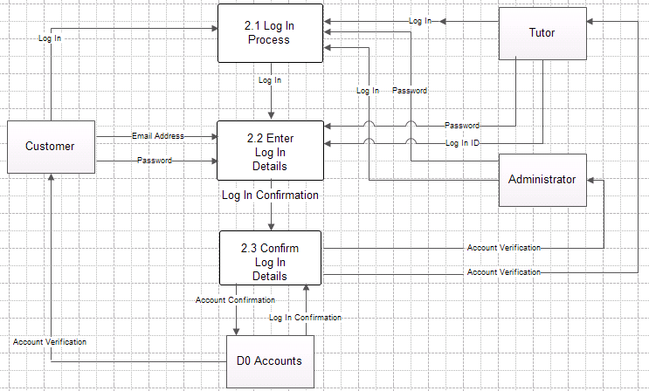
DFD - Login Process

Slide 13
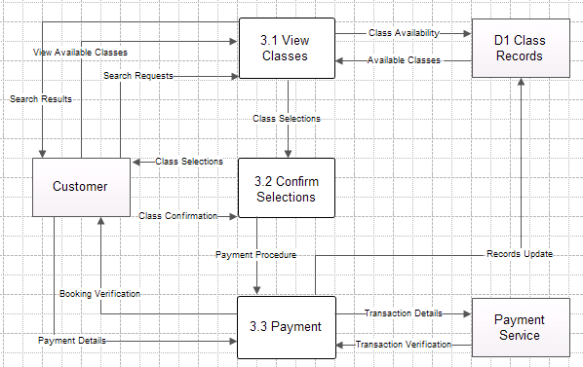
DFD - Book/Payment of classes

Slide 14
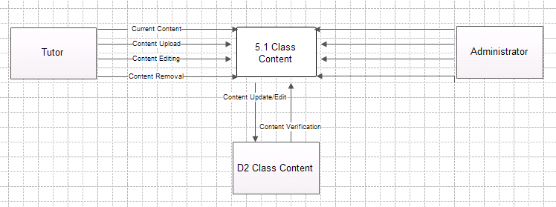
DFD - Manage/Update class content

